Slide 1
COT5615: Math for Intelligent Systems I
Anand Rangarajan
Lecture 34

Slide 2
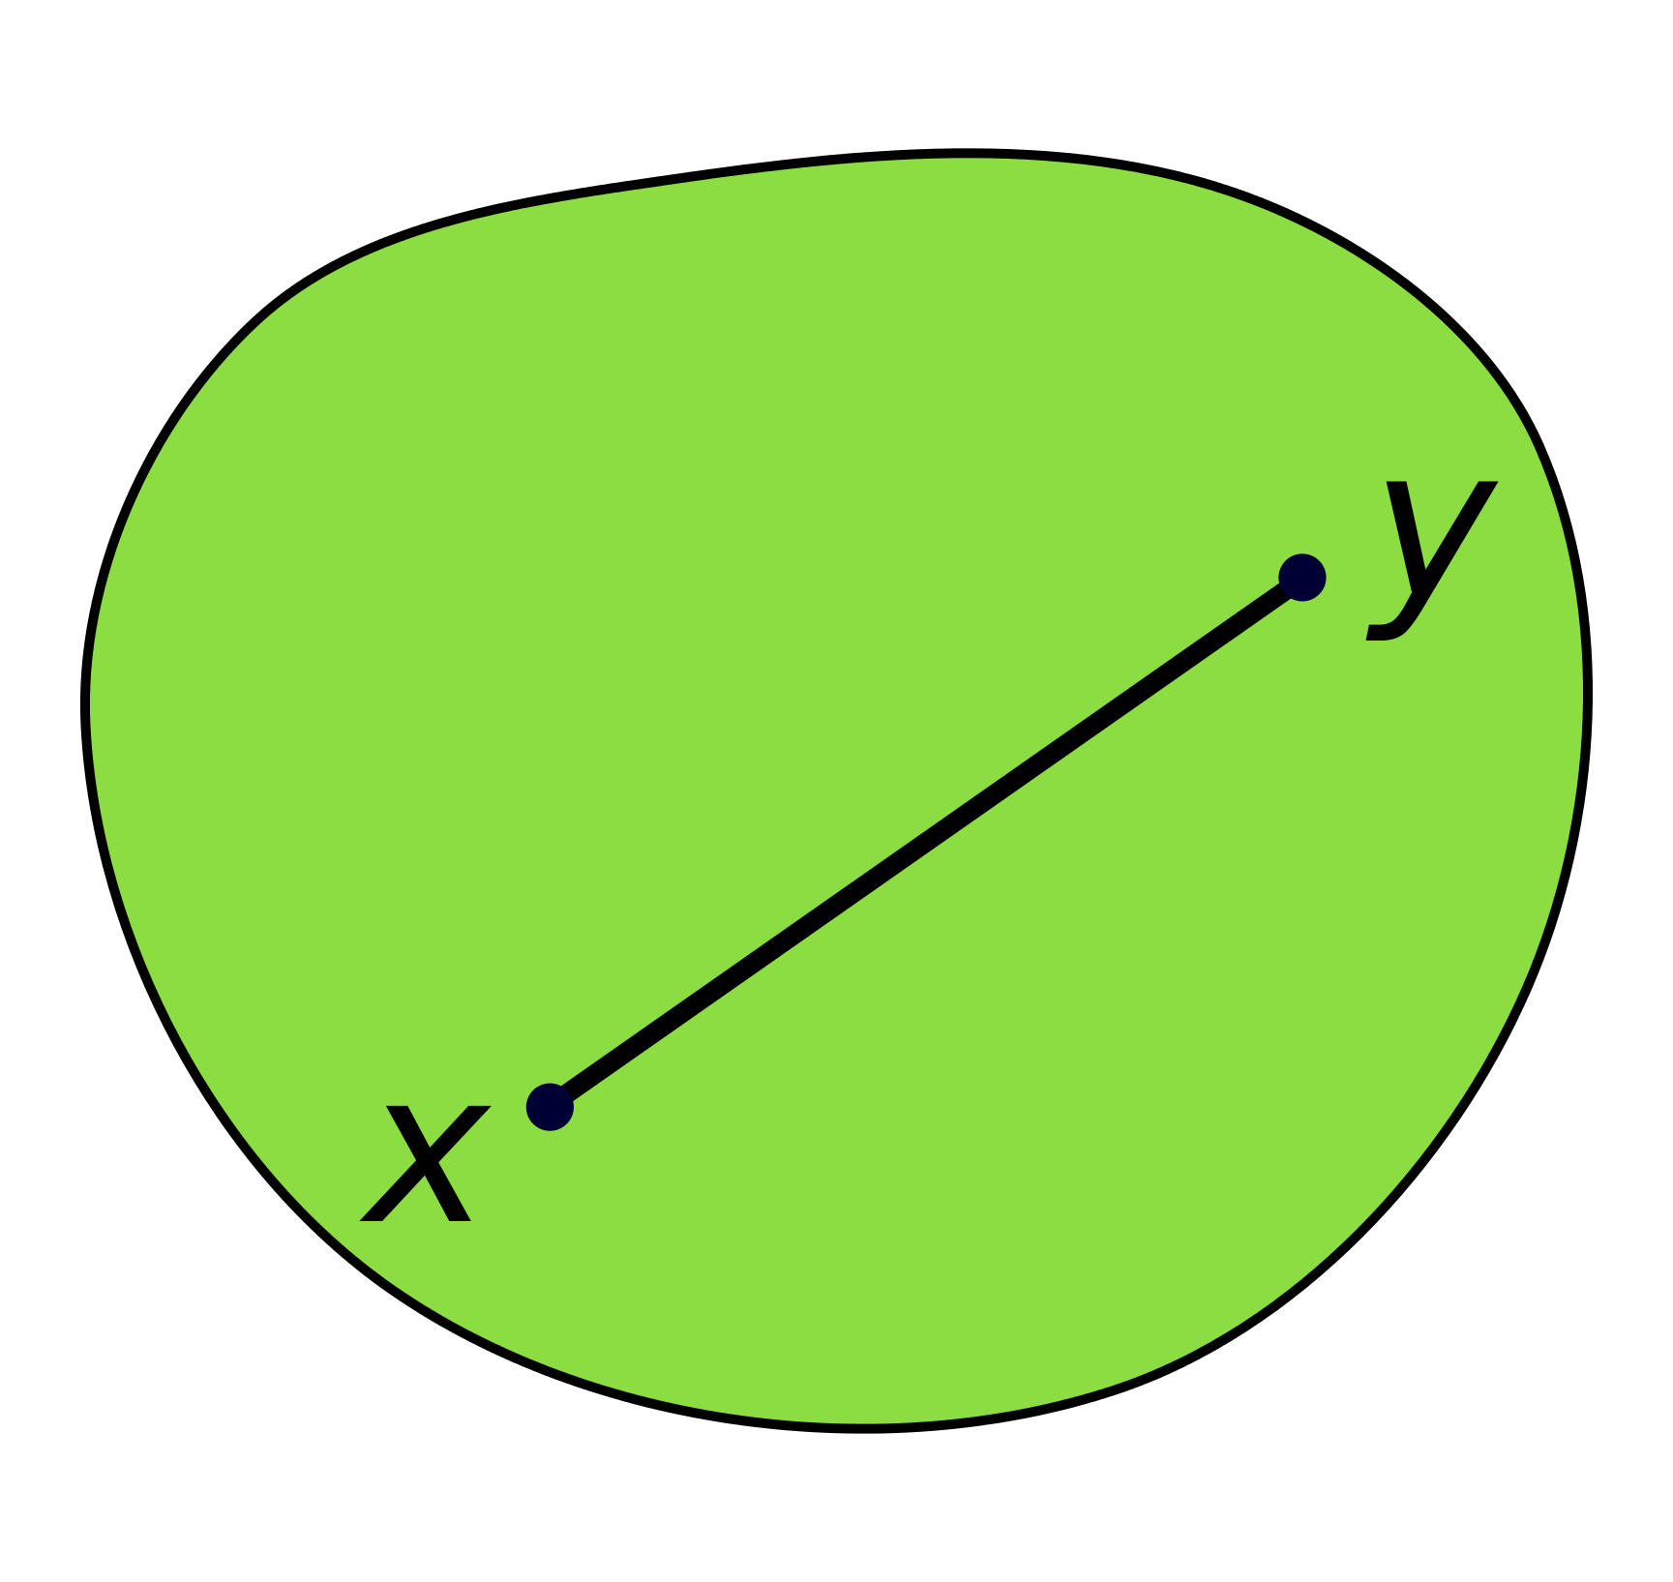
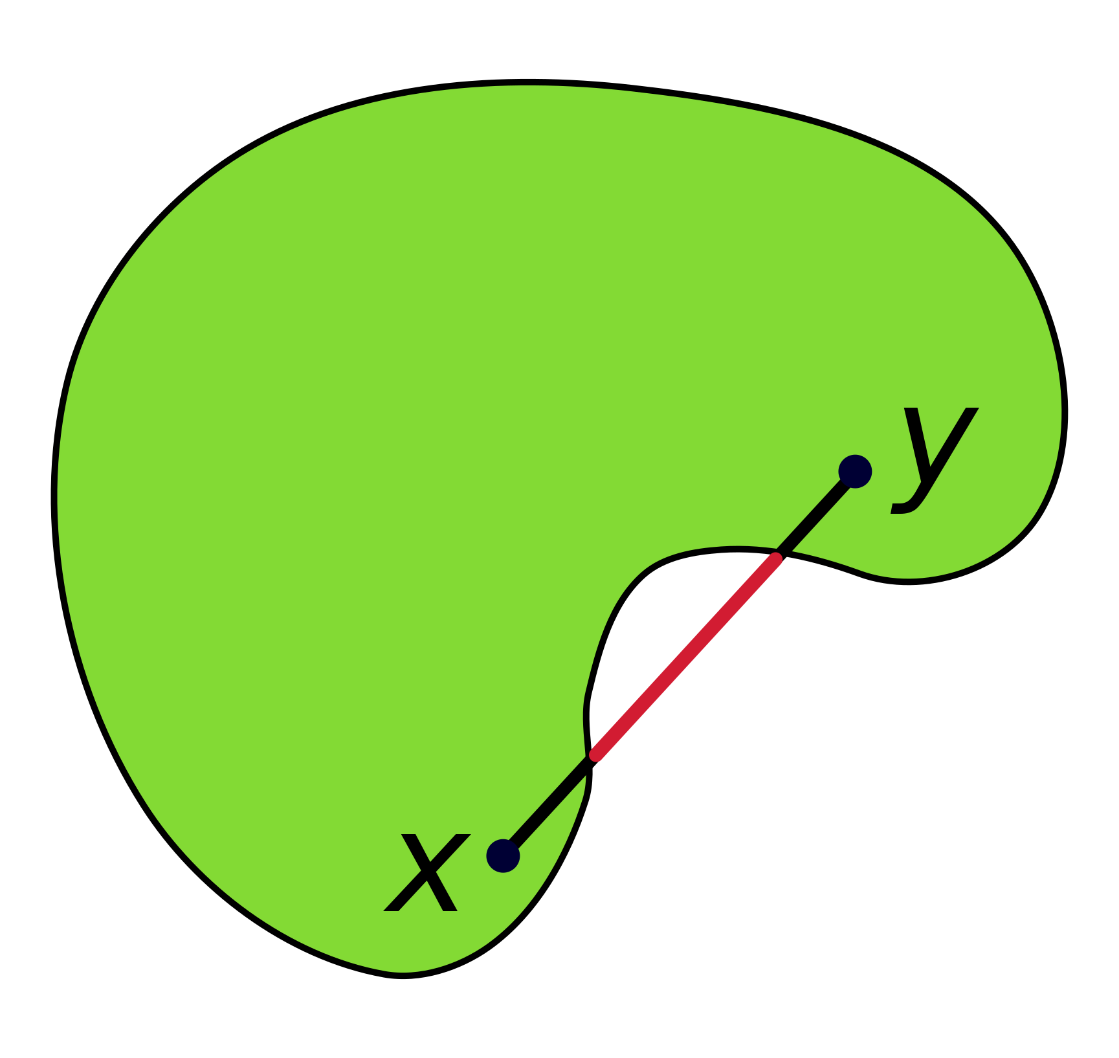
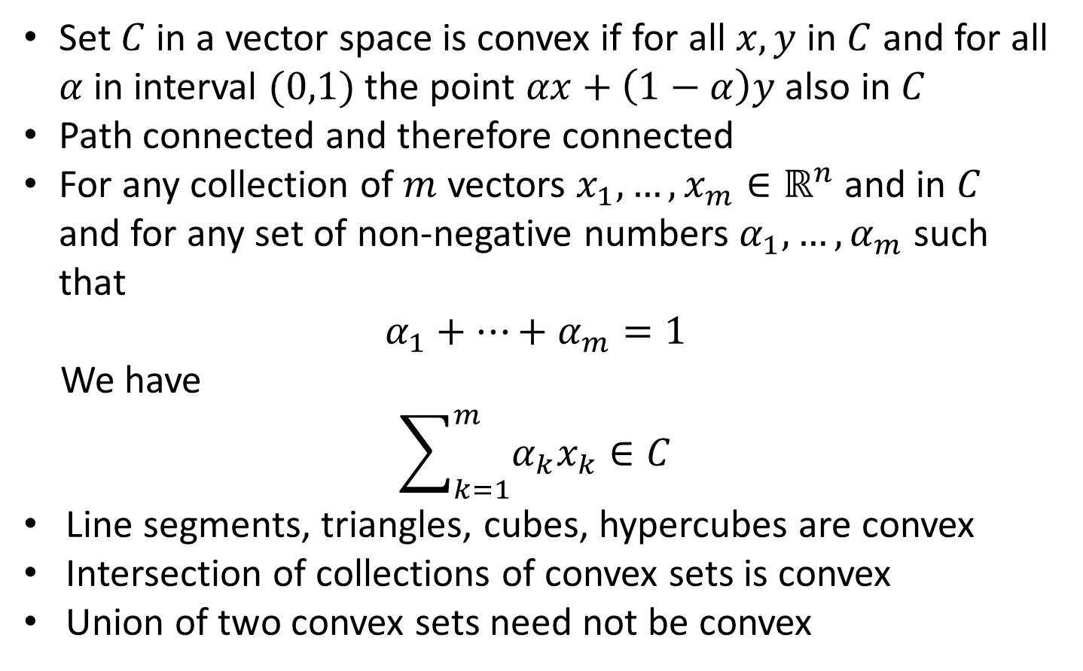
Convexity
Convex Set
Set $C$ in a vector space is convex if for all $x,y$ in $C$ and for all $α$ in interval $(0,1)$ the point $αx+\left(1−α\right)y$ also in $C$
Path connected and therefore connected
For any collection of $m$ vectors $x_{1},…,x_{m}∈ℝ^{n}$ and in $C$ and for any set of non-negative numbers $α_{1},…,α_{m}$ such that
$$α_{1}+…+α_{m}=1$$
We have
$$\sum_{k=1}^{m}{α_{k}x_{k}}∈C$$
Line segments, triangles, cubes, hypercubes are convex
Intersection of collections of convex sets is convex
Union of two convex sets need not be convex
Non-convex Set
Source: CheCheDaWaff (Wikipedia)

Slide 3
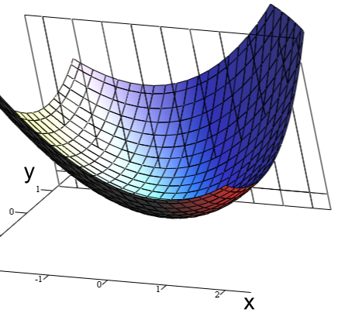
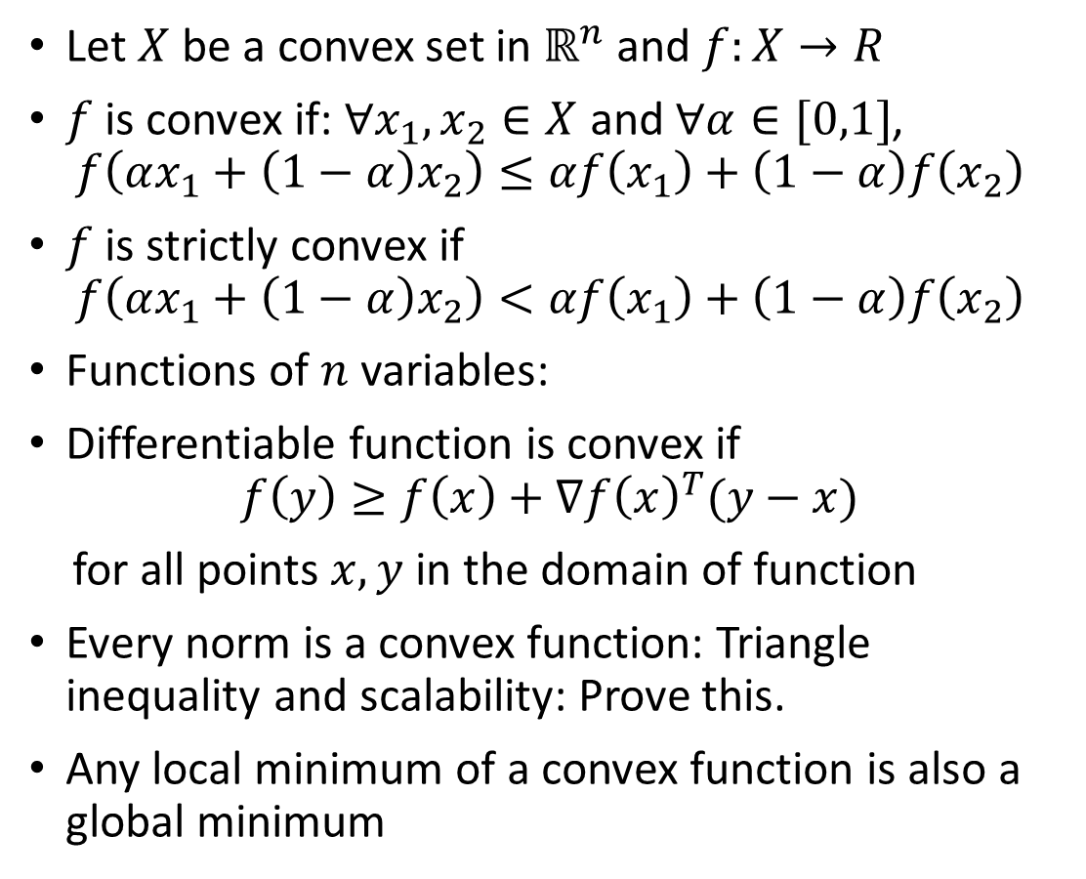
Convex Functions
Let $X$ be a convex set in $ℝ^{n}$ and $f:X→R$
$f$ is convex if: $∀x_{1},x_{2}∈X$ and $∀α∈[0,1]$,
$$f\left(αx_{1}+\left(1−α\right)x_{2}\right)≤αf\left(x_{1}\right)+\left(1−α\right)f\left(x_{2}\right)$$
$f$ is strictly convex if
$$f\left(αx_{1}+\left(1−α\right)x_{2}\right)<αf\left(x_{1}\right)+\left(1−α\right)f\left(x_{2}\right)$$
Functions of $n$ variables:
Differentiable function is convex if
$$f\left(y\right)≥f\left(x\right)+∇f{\left(x\right)}^{T}(y−x)$$
for all points $x,y$ in the domain of function
Every norm is a convex function: Triangle inequality and scalability: Prove this.
Any local minimum of a convex function is also a global minimum
Source: Indeed123 (Wikipedia)

Slide 4
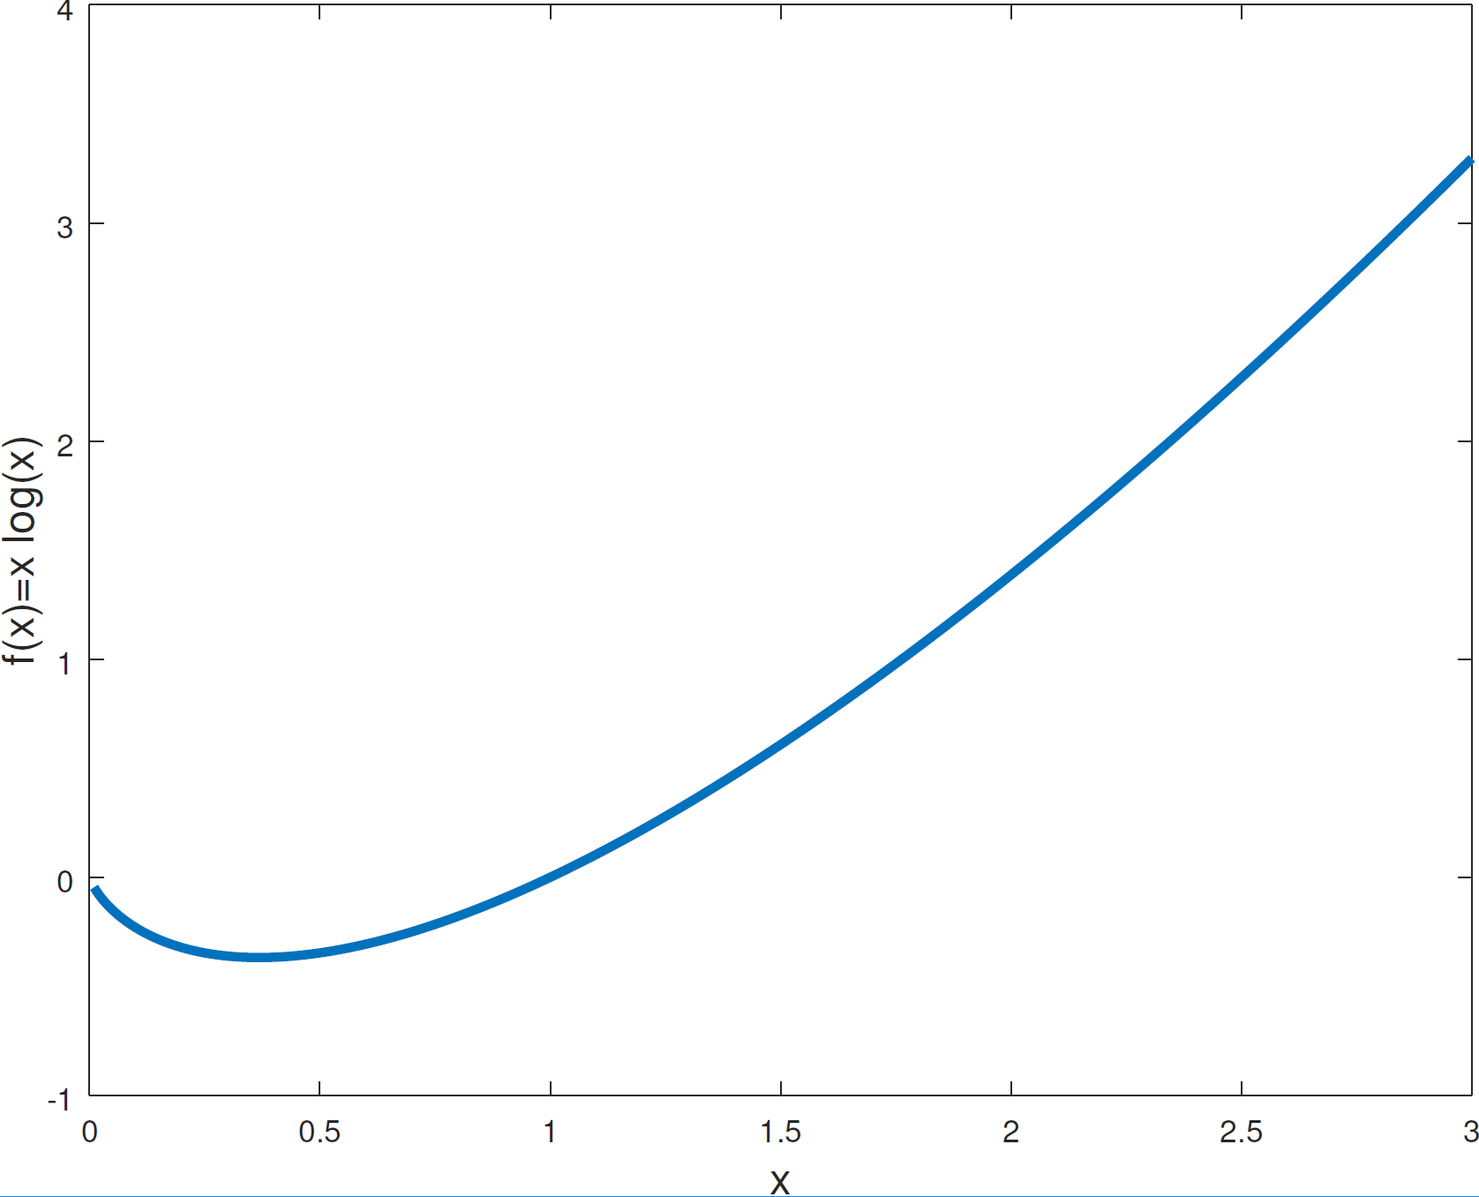
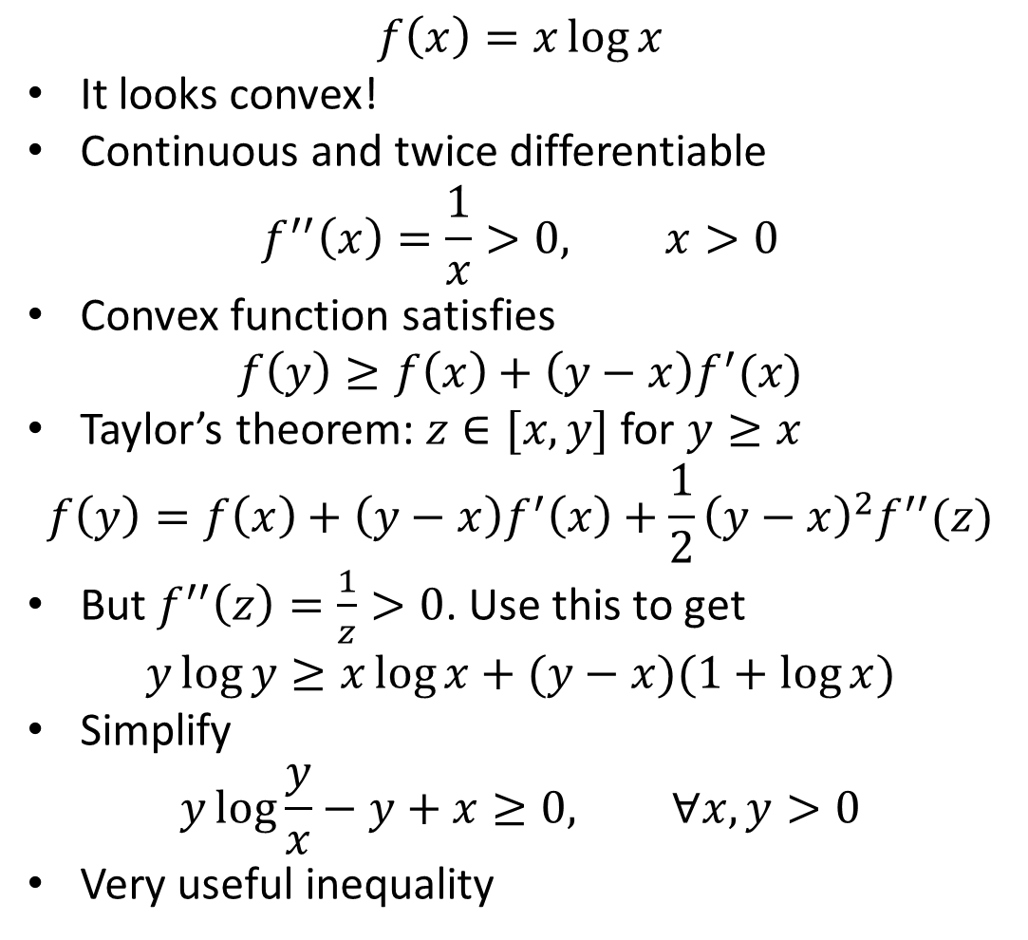
A Simple 1D Example
$$f\left(x\right)=x\log{x}$$
It looks convex!
Continuous and twice differentiable
$$f^{′′}\left(x\right)=\frac{1}{x}>0, x>0$$
Convex function satisfies
$$f\left(y\right)≥f\left(x\right)+\left(y−x\right)f^{′}(x)$$
Taylor’s theorem: $z∈[x,y]$ for $y≥x$
$$f\left(y\right)=f\left(x\right)+\left(y−x\right)f^{′}\left(x\right)+\frac{1}{2}{\left(y−x\right)}^{2}f^{′′}(z)$$
But $f^{′′}\left(z\right)=\frac{1}{z}>0$. Use this to get
$$y\log{y}≥x\log{x+(y−x)(1+\log{x})}$$
Simplify
$$y\log{\frac{y}{x}}−y+x≥0, ∀x,y>0$$
Very useful inequality

Slide 5
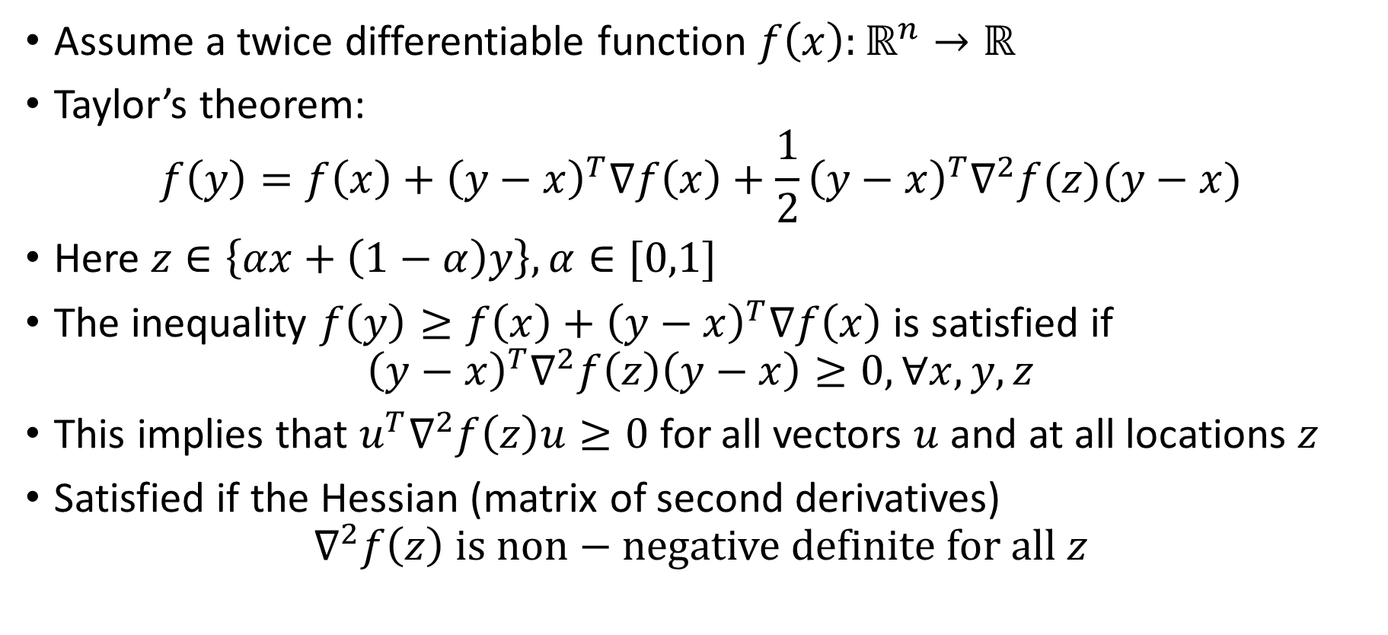
Convexity in higher dimensions
Assume a twice differentiable function $f\left(x\right):ℝ^{n}→ℝ$
Taylor’s theorem:
$$f\left(y\right)=f\left(x\right)+{\left(y−x\right)}^{T}∇f\left(x\right)+\frac{1}{2}{\left(y−x\right)}^{T}∇^{2}f(z)(y−x)$$
Here $z∈\left\{αx+\left(1−α\right)y\right\},α∈[0,1]$
The inequality $f\left(y\right)≥f\left(x\right)+{\left(y−x\right)}^{T}∇f\left(x\right)$ is satisfied if
$${\left(y−x\right)}^{T}∇^{2}f\left(z\right)\left(y−x\right)≥0,∀x,y,z$$
This implies that $u^{T}∇^{2}f\left(z\right)u≥0$ for all vectors $u$ and at all locations $z$
Satisfied if the Hessian (matrix of second derivatives)
$$∇^{2}f\left(z\right) is non−negative definite for all z$$

Slide 6
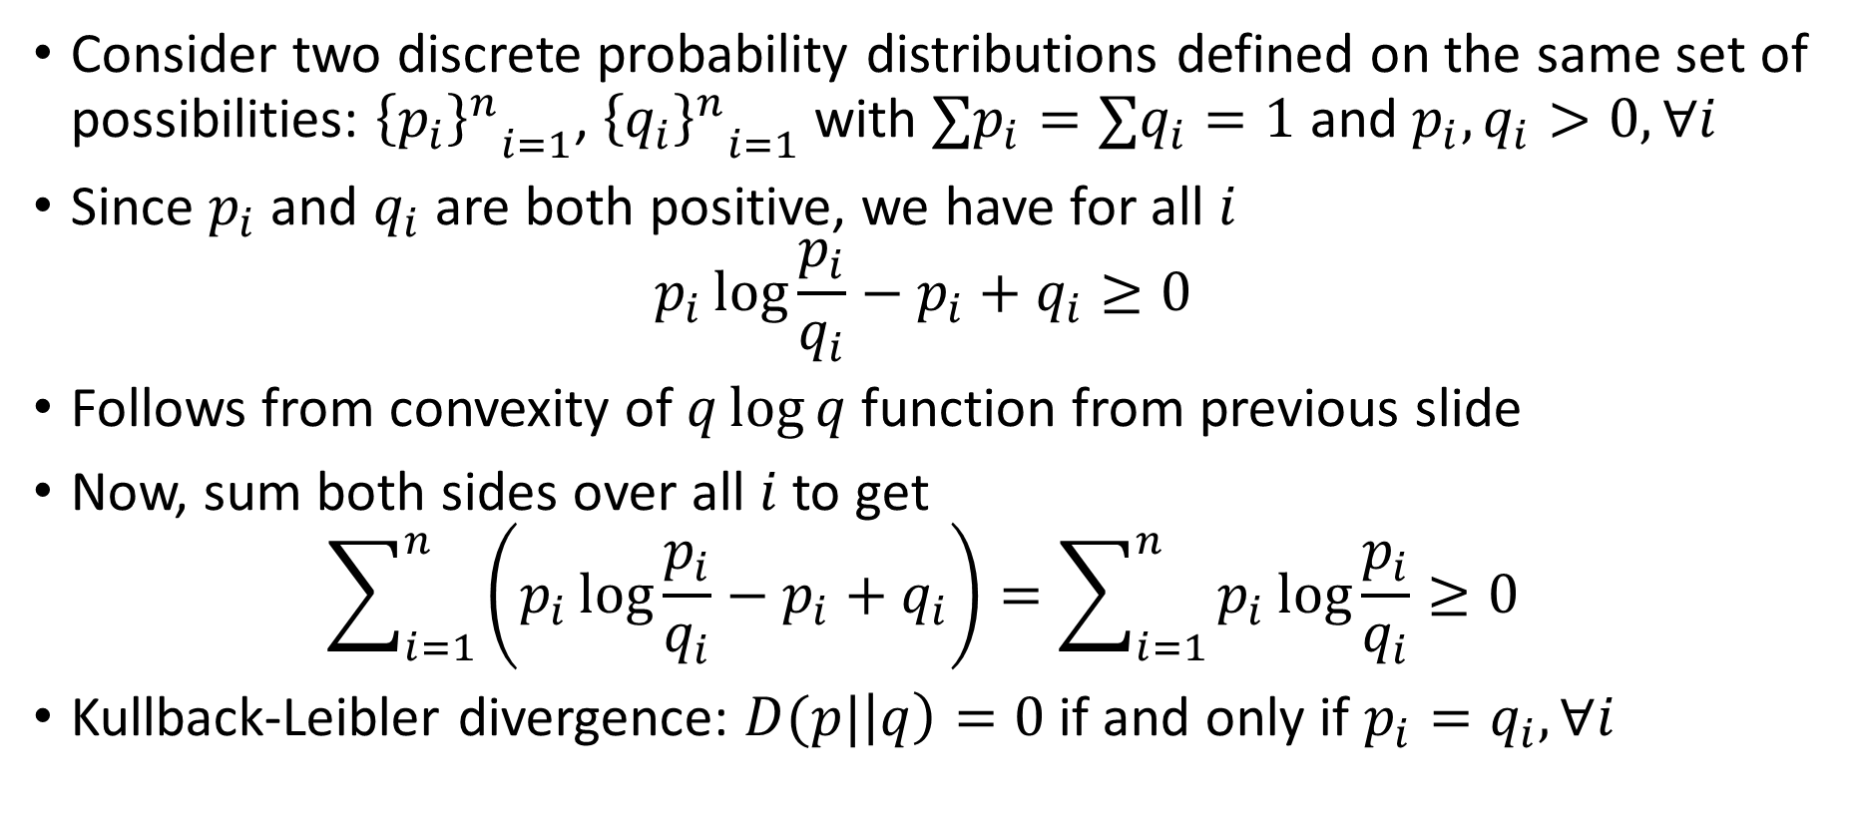
The Kullback-Leibler (KL) divergence
Consider two discrete probability distributions defined on the same set of possibilities: ${{\left\{p_{i}\right\}}^{n}}_{i=1}$, ${{\left\{q_{i}\right\}}^{n}}_{i=1}$ with $∑p_{i}=∑q_{i}=1$ and $p_{i},q_{i}>0,∀i$
Since $p_{i}$ and $q_{i}$ are both positive, we have for all $i$
$$p_{i}\log{\frac{p_{i}}{q_{i}}}−p_{i}+q_{i}≥0$$
Follows from convexity of $q\log{q}$ function from previous slide
Now, sum both sides over all $i$ to get
$$\sum_{i=1}^{n}{\left(p_{i}\log{\frac{p_{i}}{q_{i}}}−p_{i}+q_{i}\right)}=\sum_{i=1}^{n}{p_{i}\log{\frac{p_{i}}{q_{i}}}}≥0$$
Kullback-Leibler divergence: $D(p|\left|q\right)=0$ if and only if $p_{i}=q_{i},∀i$
Notes:
This divergence will fail at very small values of qi. Please look into that as well.

Slide 7
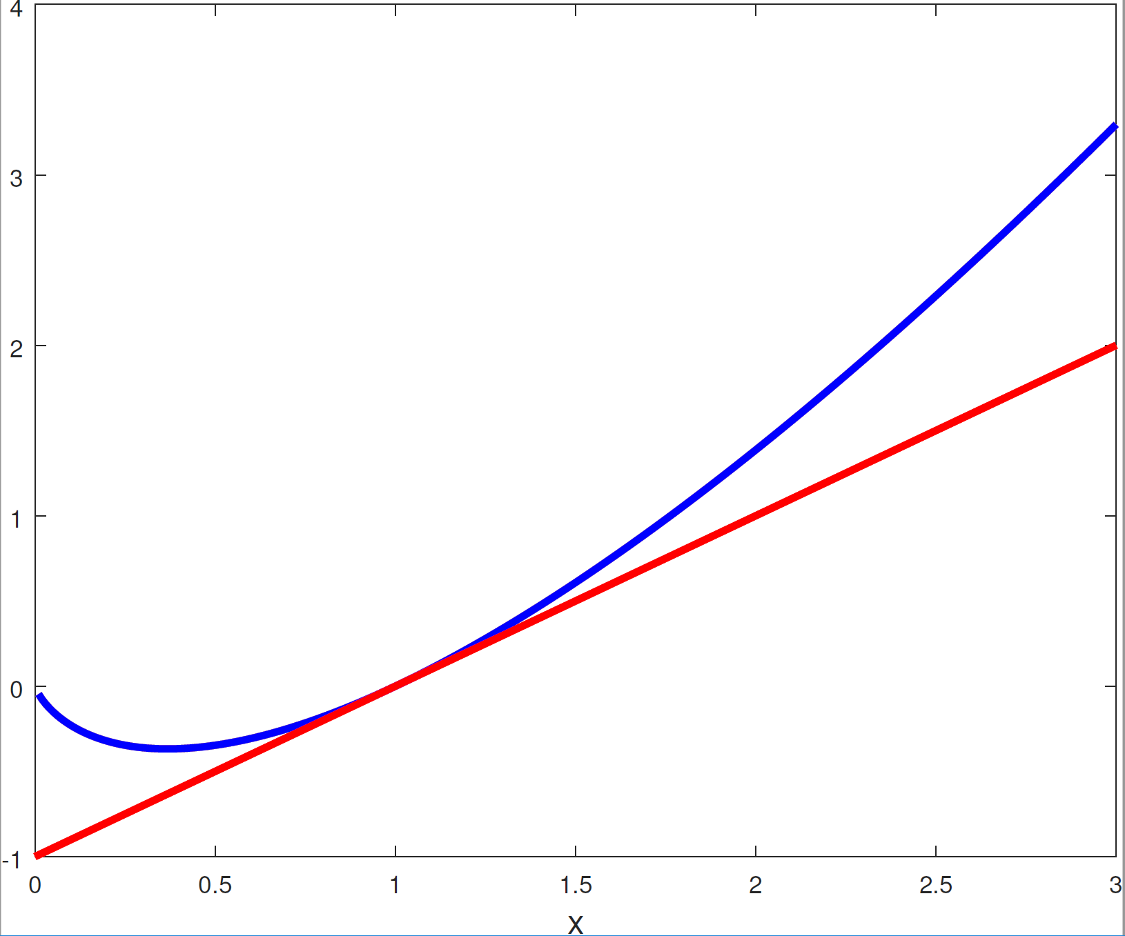
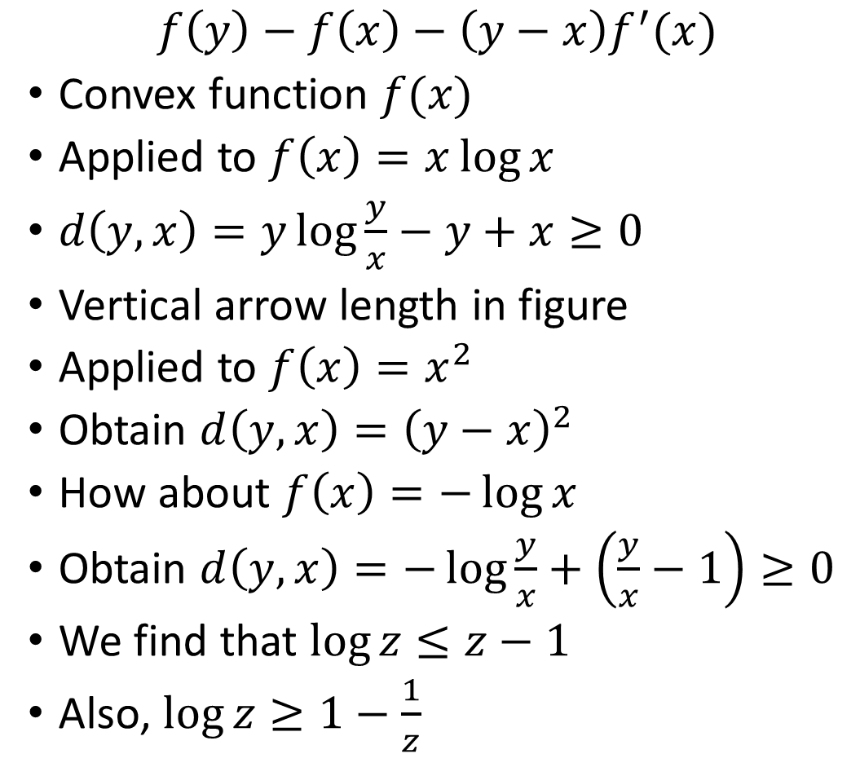
The Bregman Divergence
$$f\left(y\right)−f\left(x\right)−\left(y−x\right)f^{′}(x)$$
Convex function $f(x)$
Applied to $f\left(x\right)=x\log{x}$
$d\left(y,x\right)=y\log{\frac{y}{x}}−y+x≥0$
Vertical arrow length in figure
Applied to $f\left(x\right)=x^{2}$
Obtain $d\left(y,x\right)={\left(y−x\right)}^{2}$
How about $f\left(x\right)=−\log{x}$
Obtain $d\left(y,x\right)=−\log{\frac{y}{x}}+\left(\frac{y}{x}−1\right)≥0$
We find that $\log{z}≤z−1$
Also, $\log{z}≥1−\frac{1}{z}$

Slide 8
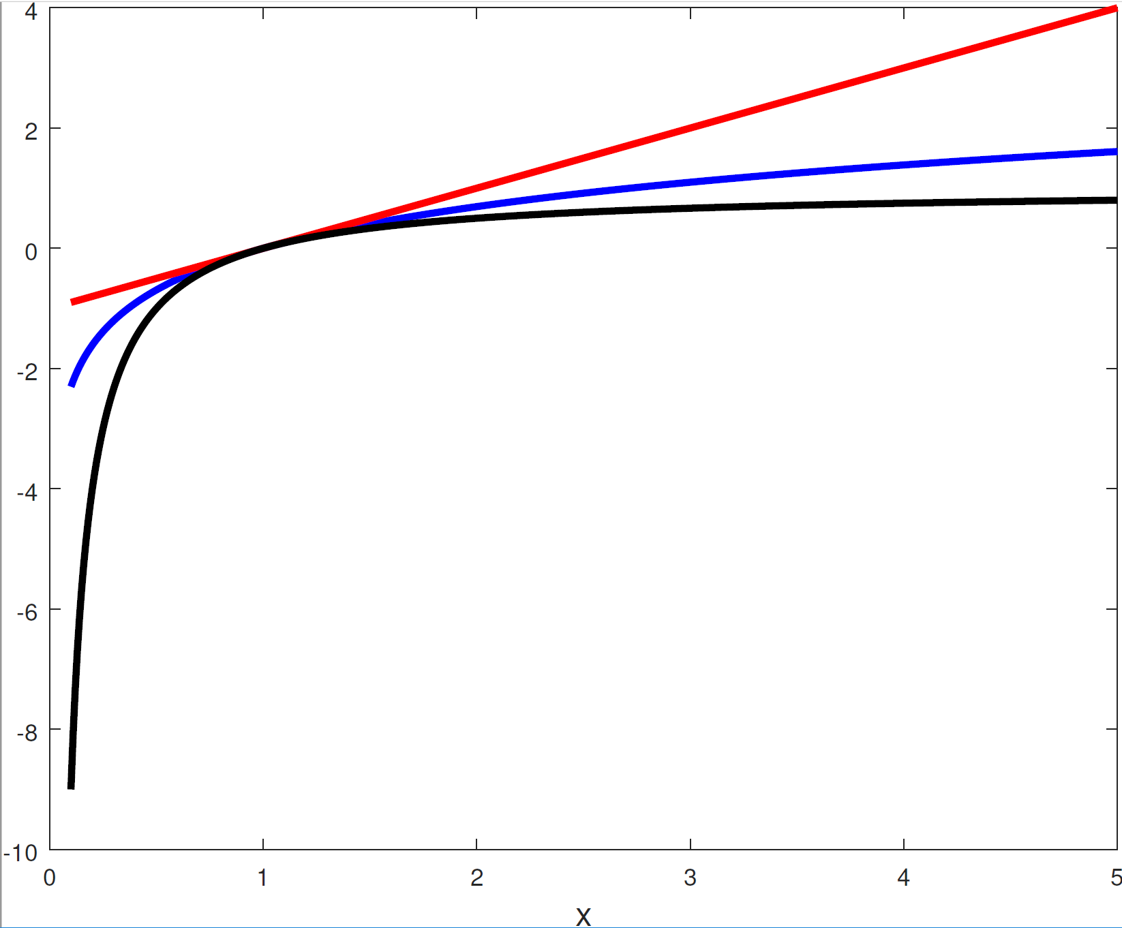
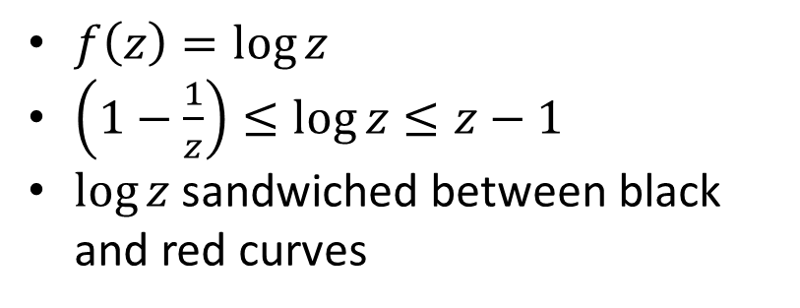

Inequalities for $\log{z}$
$f\left(z\right)=\log{z}$
$\left(1−\frac{1}{z}\right)≤\log{z}≤z−1$
$\log{z}$ sandwiched between black and red curves

Slide 9
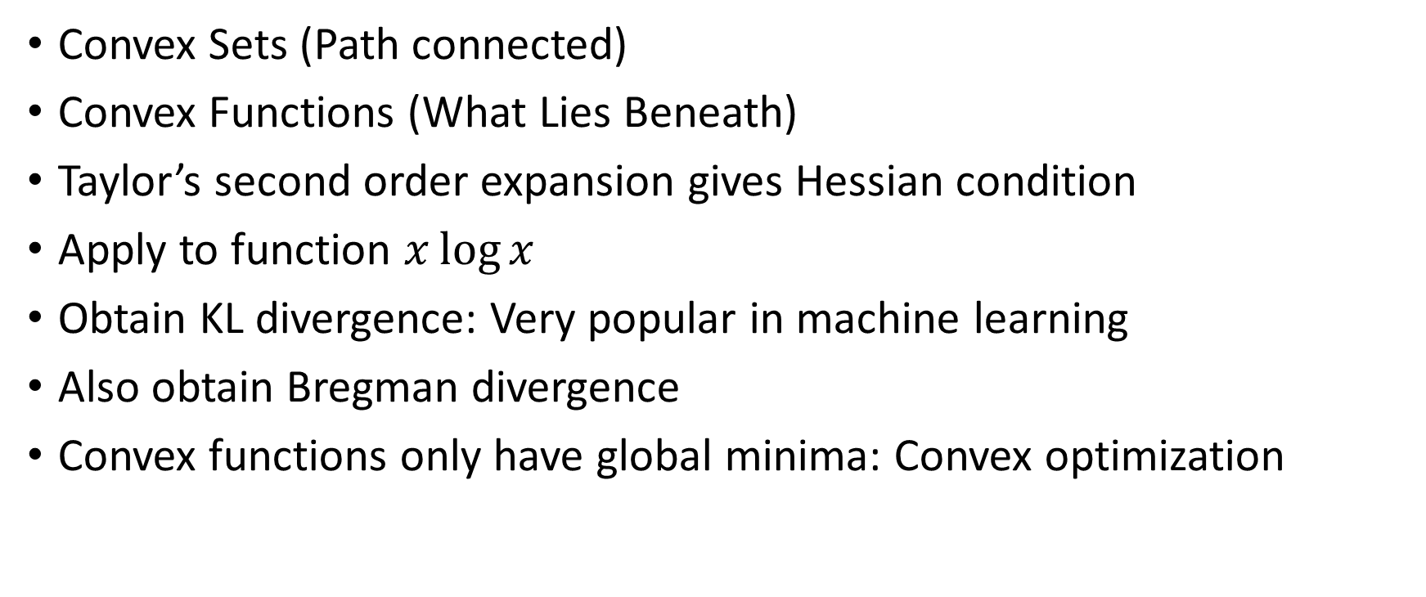
Summary
Convex Sets (Path connected)
Convex Functions (What Lies Beneath)
Taylor’s second order expansion gives Hessian condition
Apply to function $x\log{x}$
Obtain KL divergence: Very popular in machine learning
Also obtain Bregman divergence
Convex functions only have global minima: Convex optimization

